Slide 1


Social Media Analysis

Slide 2


Today's agenda
Project recap
Problem
The Analytics team
Process
Insights
Summary

Slide 3

Objective: To analyze content categories and user reactions across a social media platform.
Key metrics include the top content categories, reaction patterns, and posting trends by month.
Deliver insights that help drive decision-making and strategy.
Project Recap

Slide 4


Problem

Slide 5
What problem are we solving?
Identify the most engaging content categories.
Analyze user reactions to determine what drives engagement.
Provide insights into posting trends over time (monthly trends).
Help the client optimize their content strategy based on data-driven findings.

Slide 6



Sameera Banu M – Data Analyst
The Analytics team
Andrew Fleming - Chief Technical Architect
Marcus Rompton - Senior Principal

Slide 7
Process
1
Data Collection
Explonatory Data Analysis
2
Visualizations
3
4
Driving Insights
5
Key Findings & Next steps

Slide 8
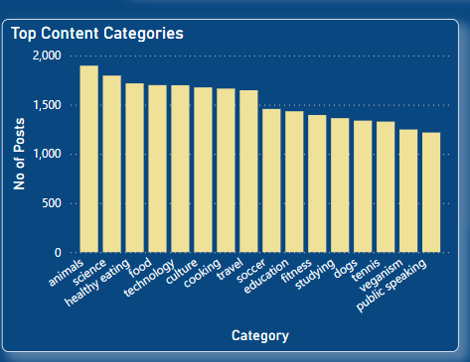

Insights
Top Content Categories:

Slide 9
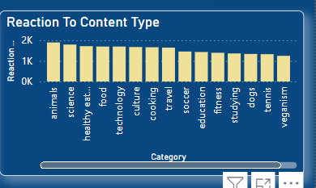
Reaction Analysis Chart

Slide 10
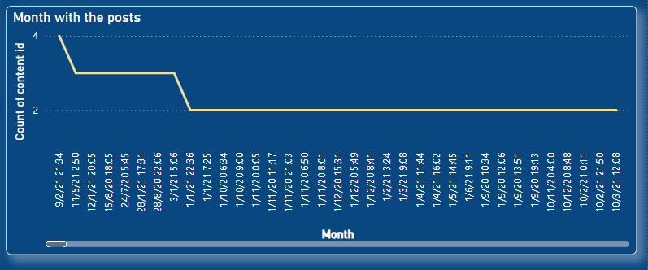
Posting Trends

Slide 11
The most reactions were received in the animal and science categories.
Posting frequency peaks in certain months; further investigation into seasonal or event-driven trends is recommended.
Actionable Recommendations:Focus more on categories that drive engagement.
Encourage posting during high-traffic months to capitalize on user activity.
Summary

Slide 12

Thank you!
ANY QUESTIONS?

